Slide 1

Quantum Information and Computing
2021 - 2022
Saverio Monaco
21/11/2021
Exercise 3

Slide 2
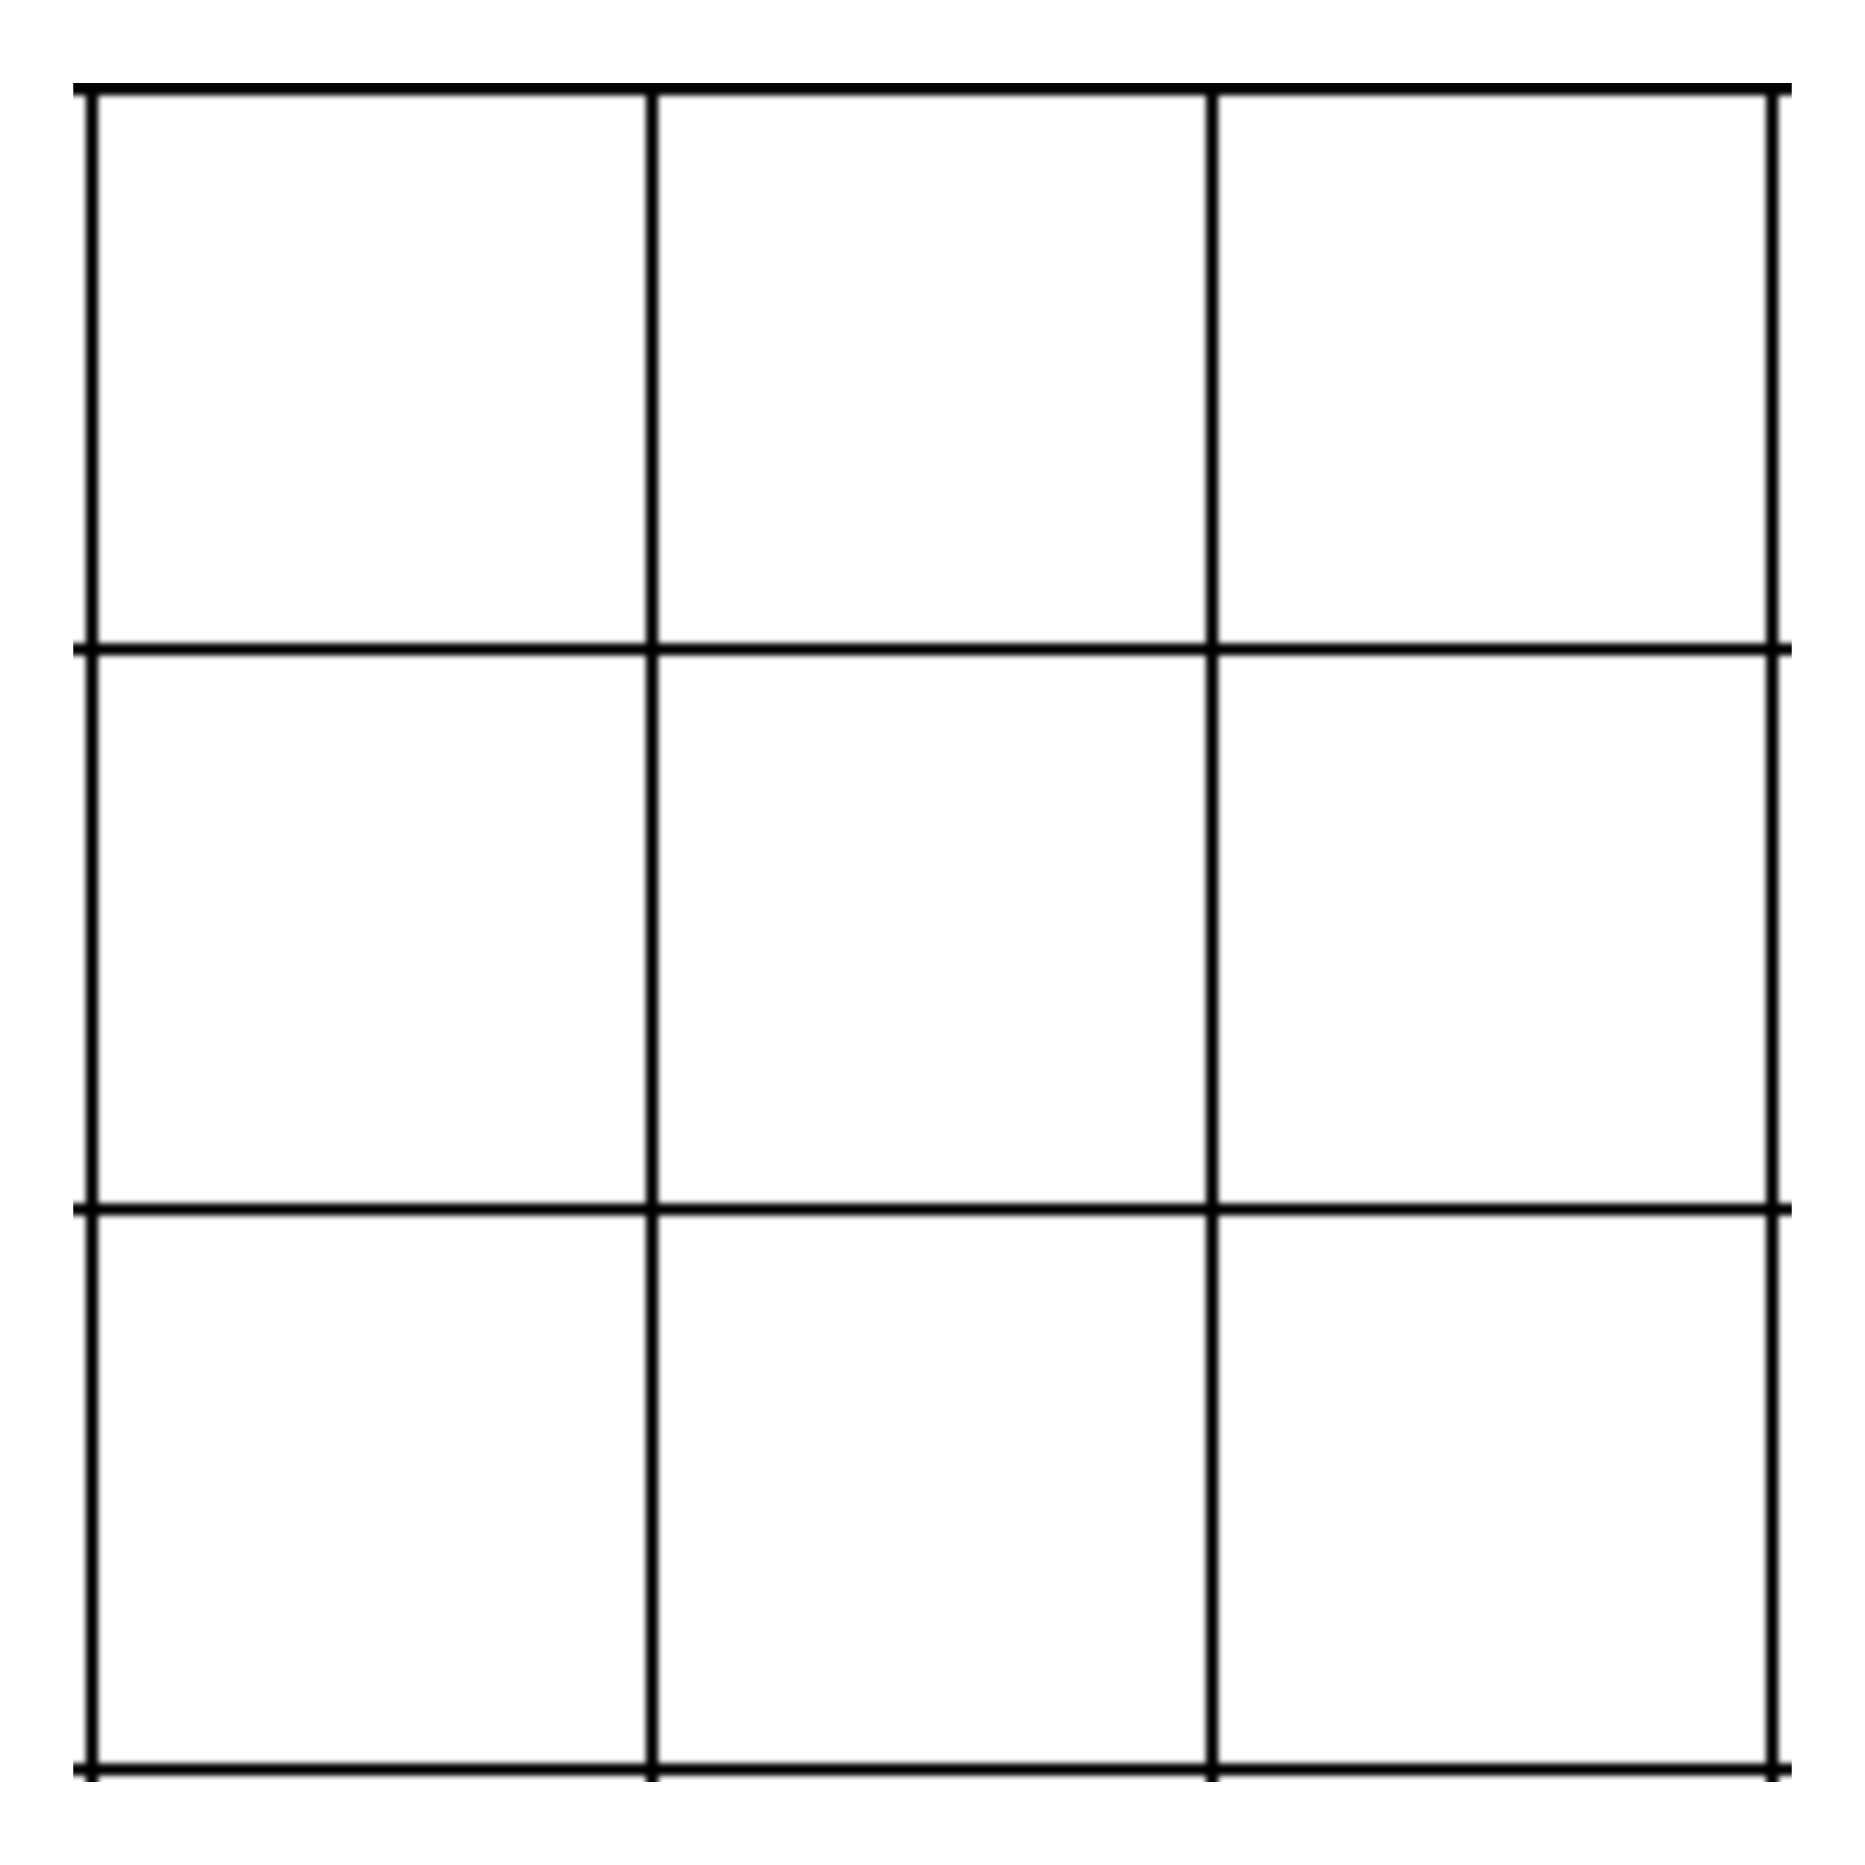
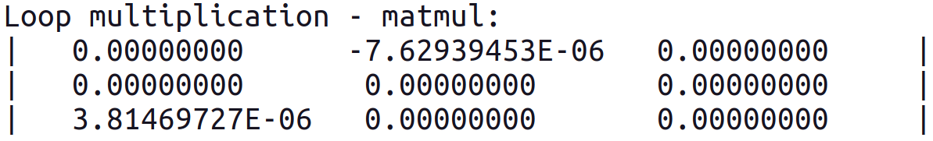


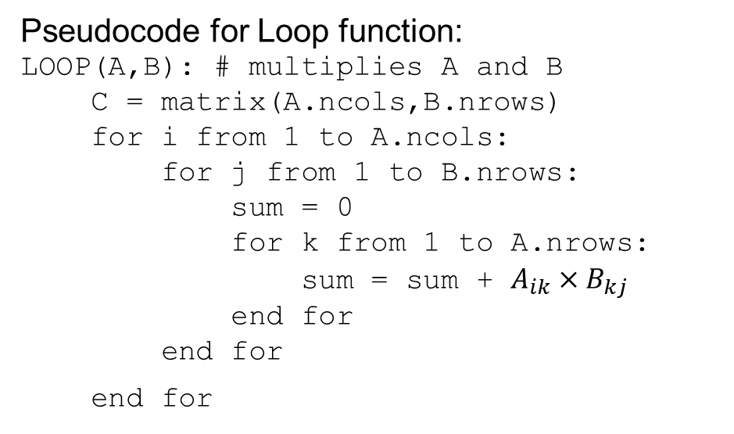

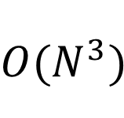

Scaling of the matrix-matrix multiplication
Pseudocode for Loop function:
LOOP(A,B): # multiplies A and B
C = matrix(A.ncols,B.nrows)
for i from 1 to A.ncols:
for j from 1 to B.nrows:
sum = 0
for k from 1 to A.nrows:
sum = sum + $A_{ik}×B_{kj}$
end for
end for
end for
Loop method
Loop2 method
(not chache optimized)
$$O(N^{3})$$
Notes:
Explain very briefly the theory you have based your solution on

Slide 3
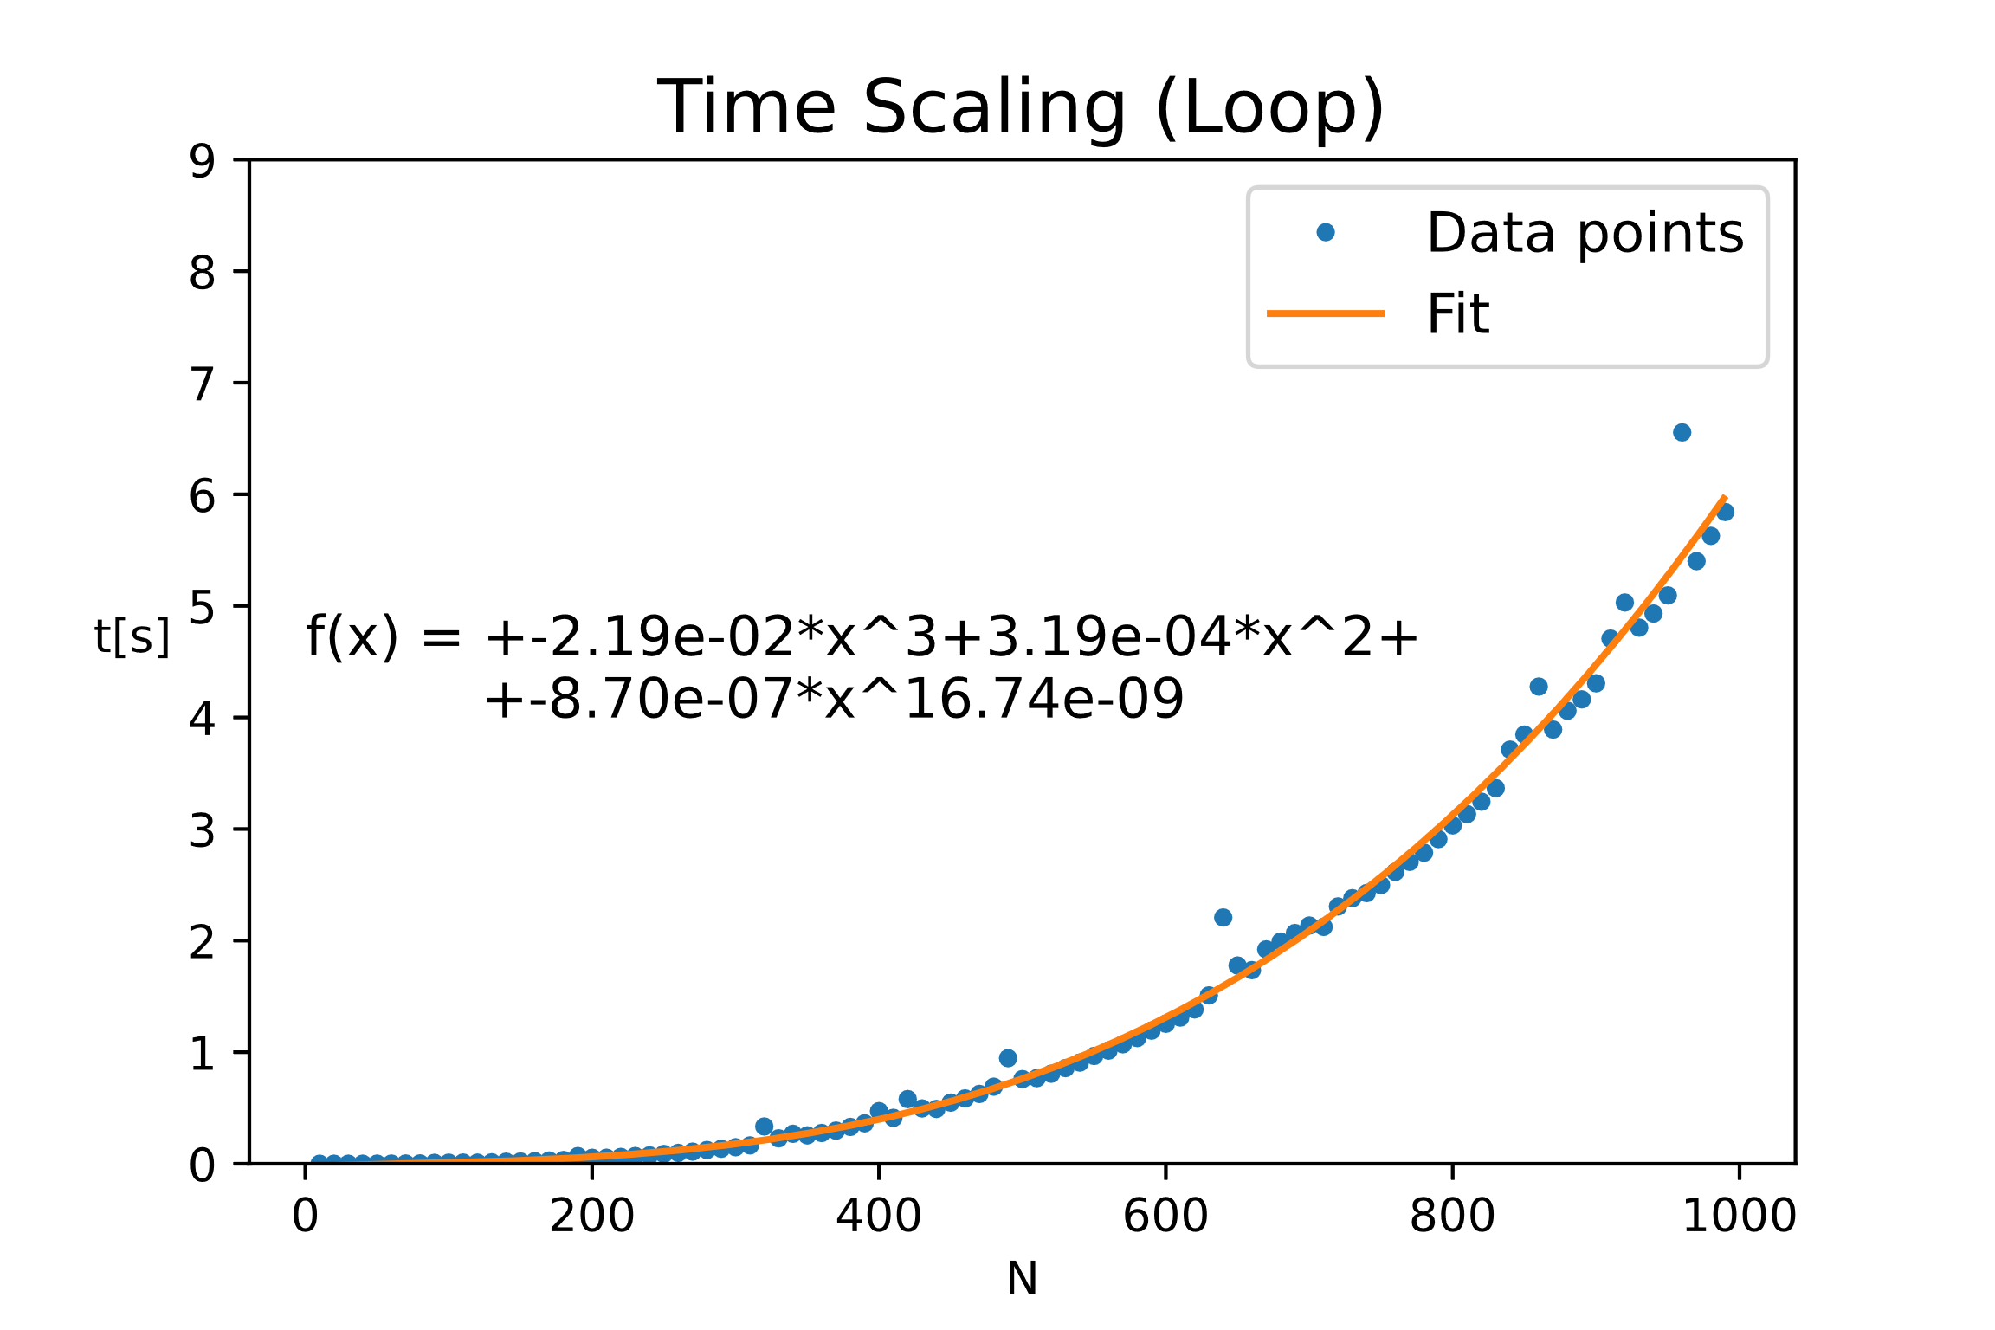
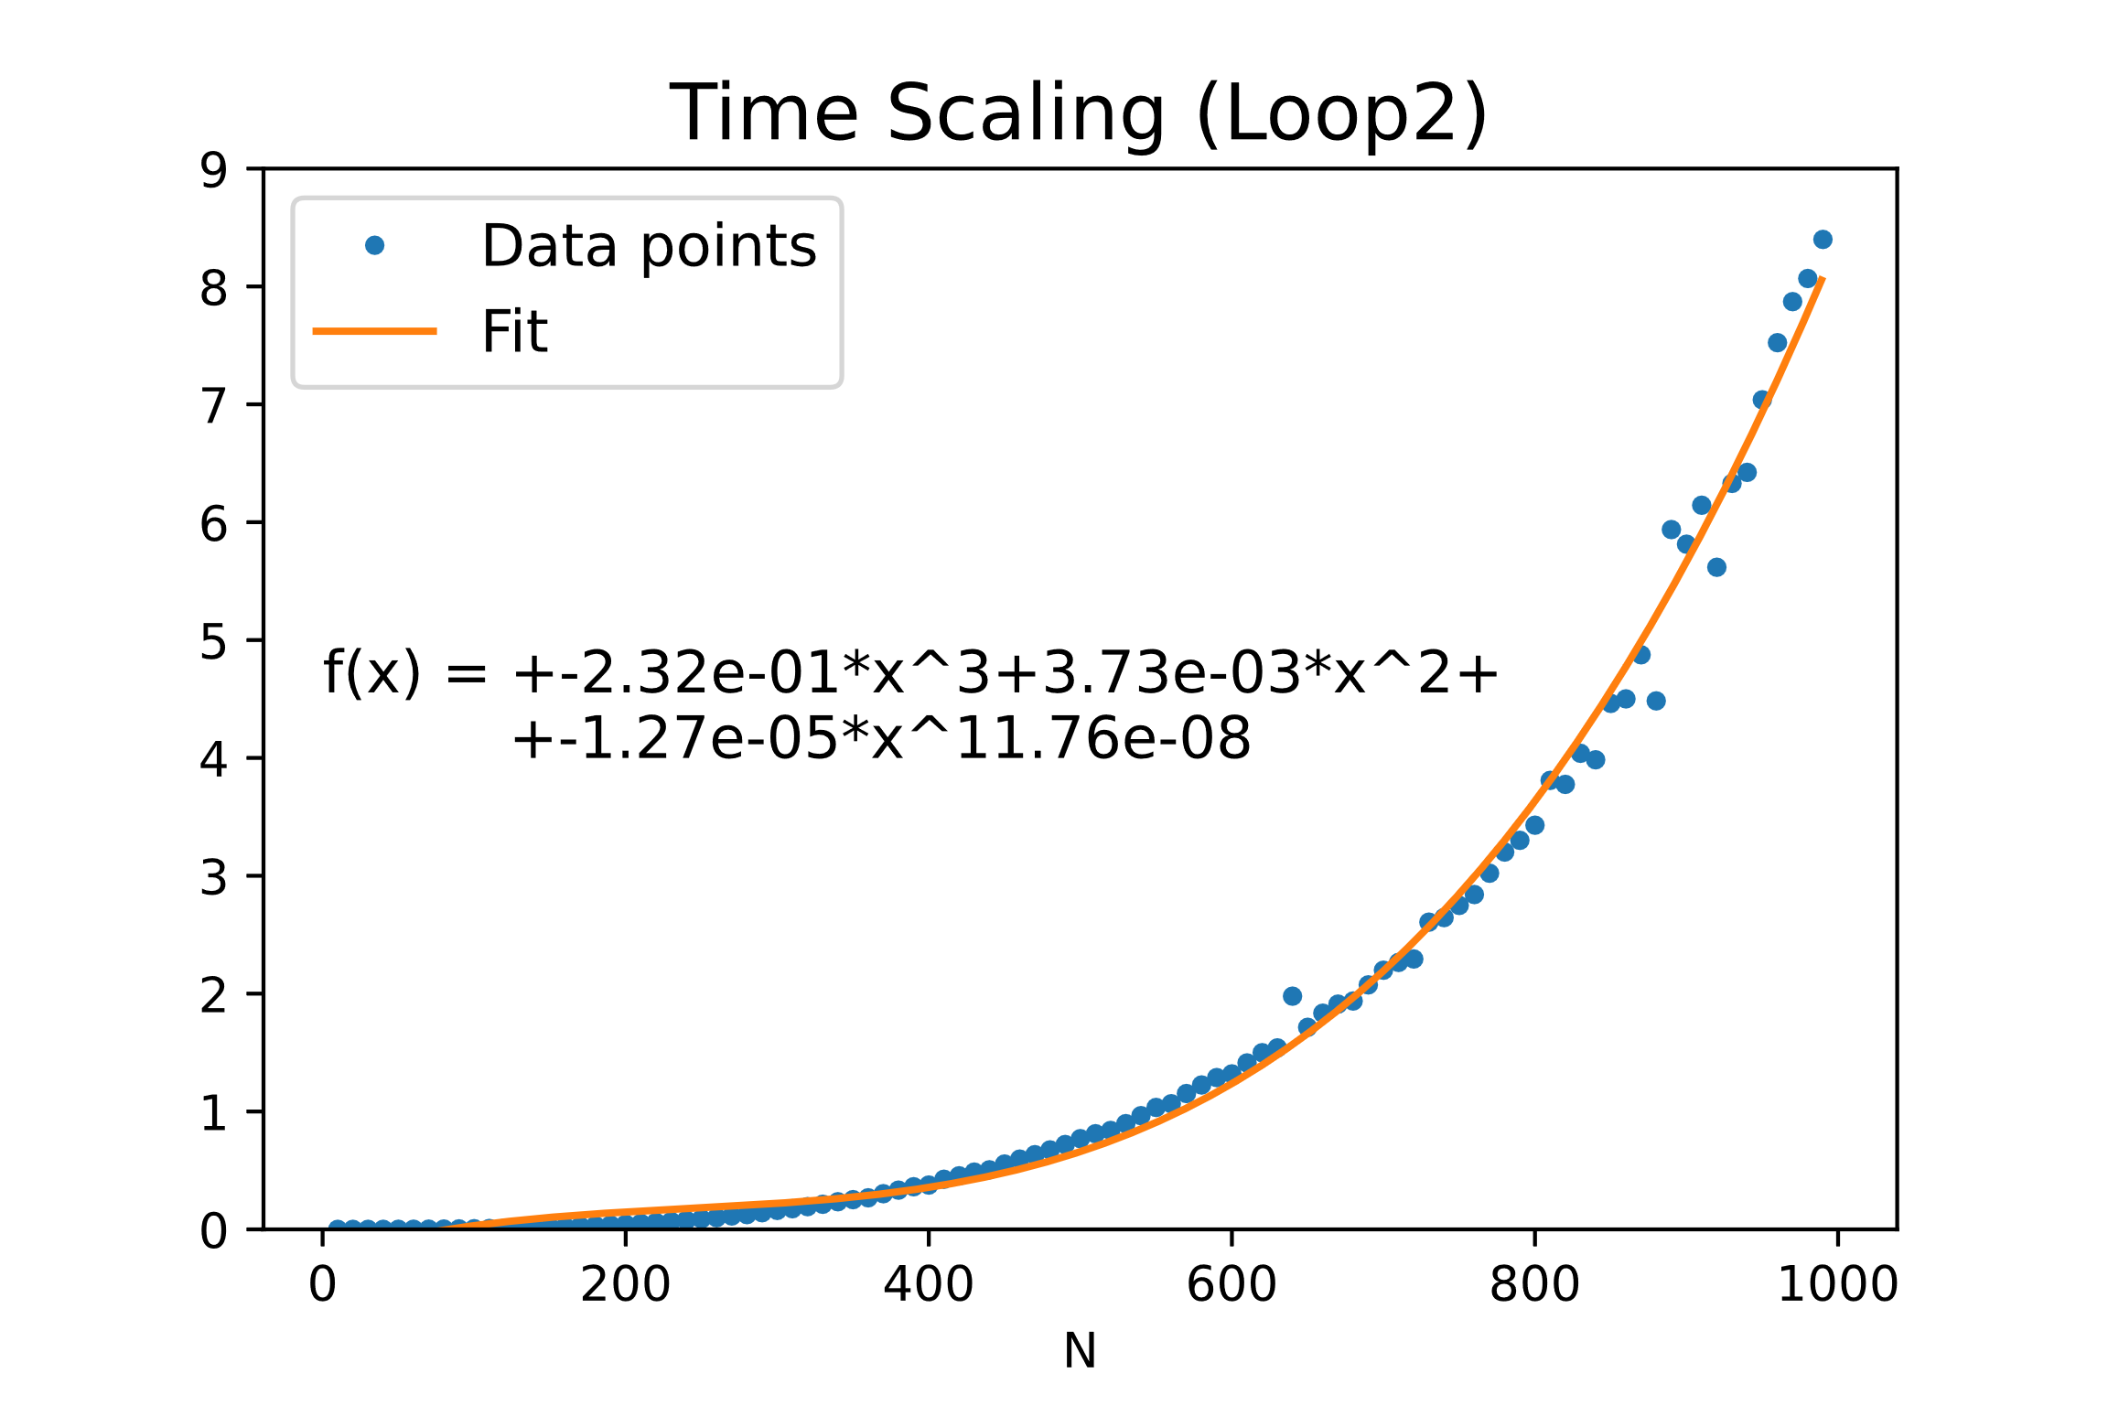
Scaling of the matrix-matrix multiplication
Notes:
Explain very briefly the theory you have based your solution on

Slide 4
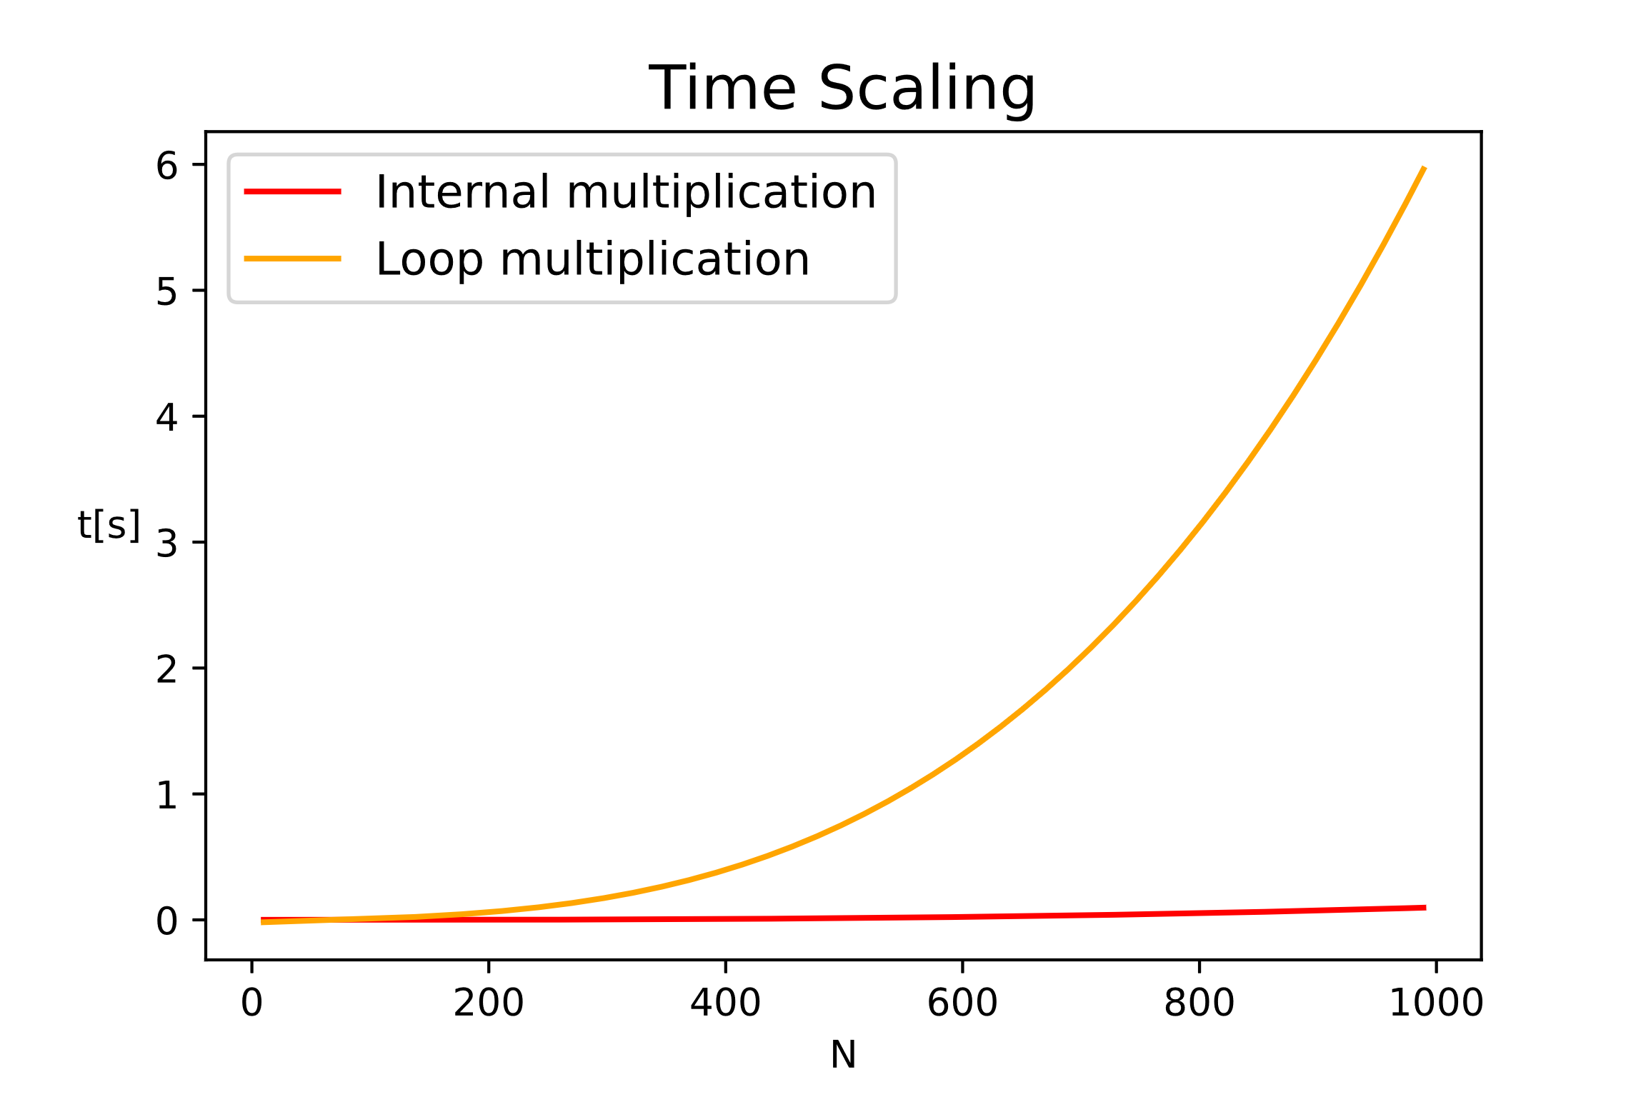
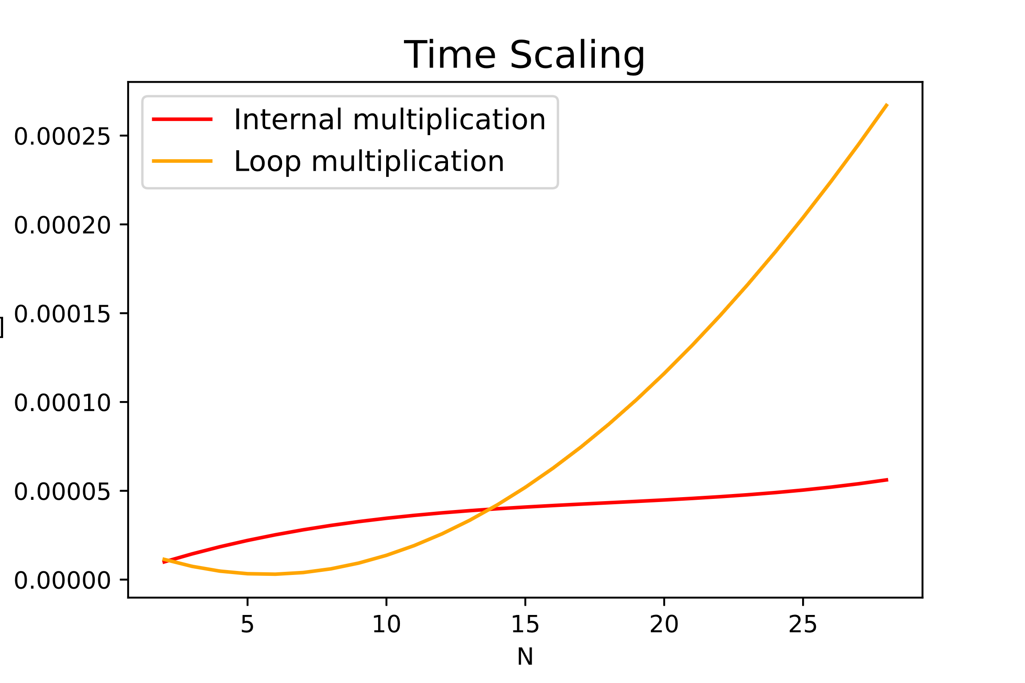
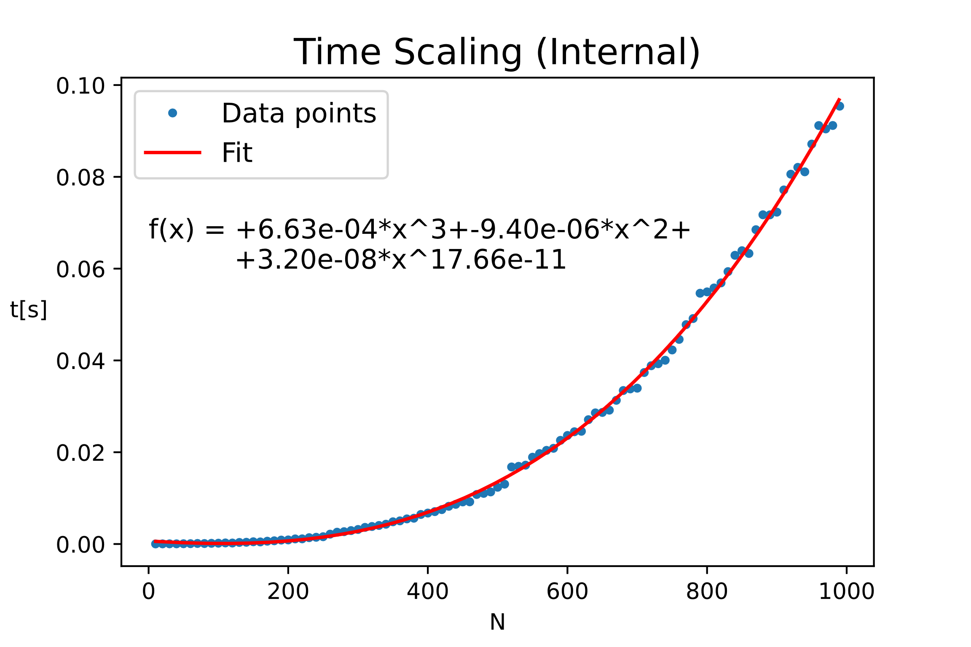
Scaling of the matrix-matrix multiplication
Notes:
Explain very briefly the theory you have based your solution on

Slide 5
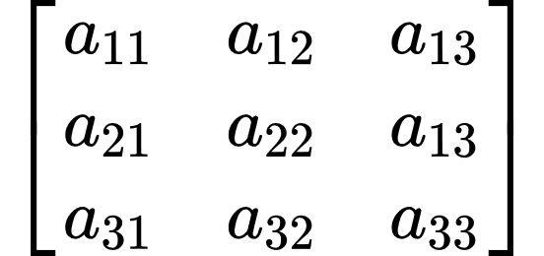
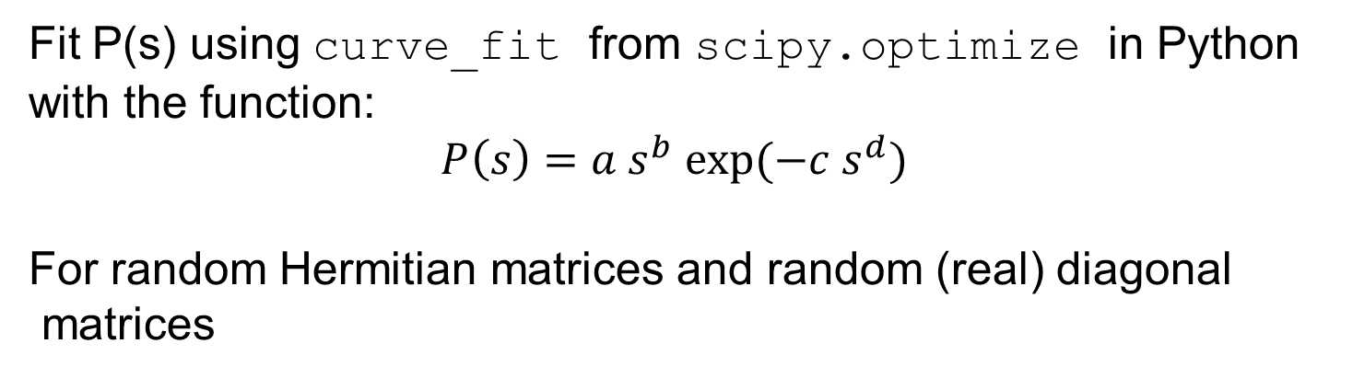
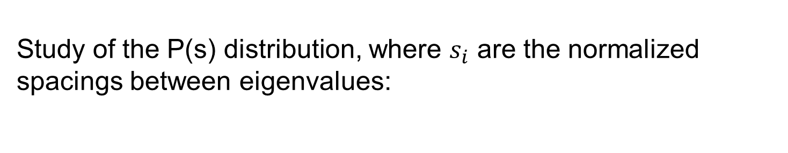
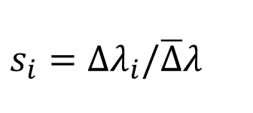
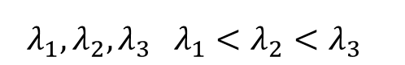
Random Matrix Theory
Study of the P(s) distribution, where $s_{i}$ are the normalized
spacings between eigenvalues:
$$s_{i}=Δλ_{i}/\overline{Δ}λ$$
$$λ_{1},λ_{2},λ_{3} λ_{1}<λ_{2}<λ_{3}$$
ZHEEV() (Lapack)
Fit P(s) using curve_fit from scipy.optimize in Python
with the function:
$$P\left(s\right)=a s^{b} exp⁡(−c s^{d})$$
For random Hermitian matrices and random (real) diagonal
matrices
Notes:
Introduce strategies, tests, and report debugging problems, compilation options

Slide 6
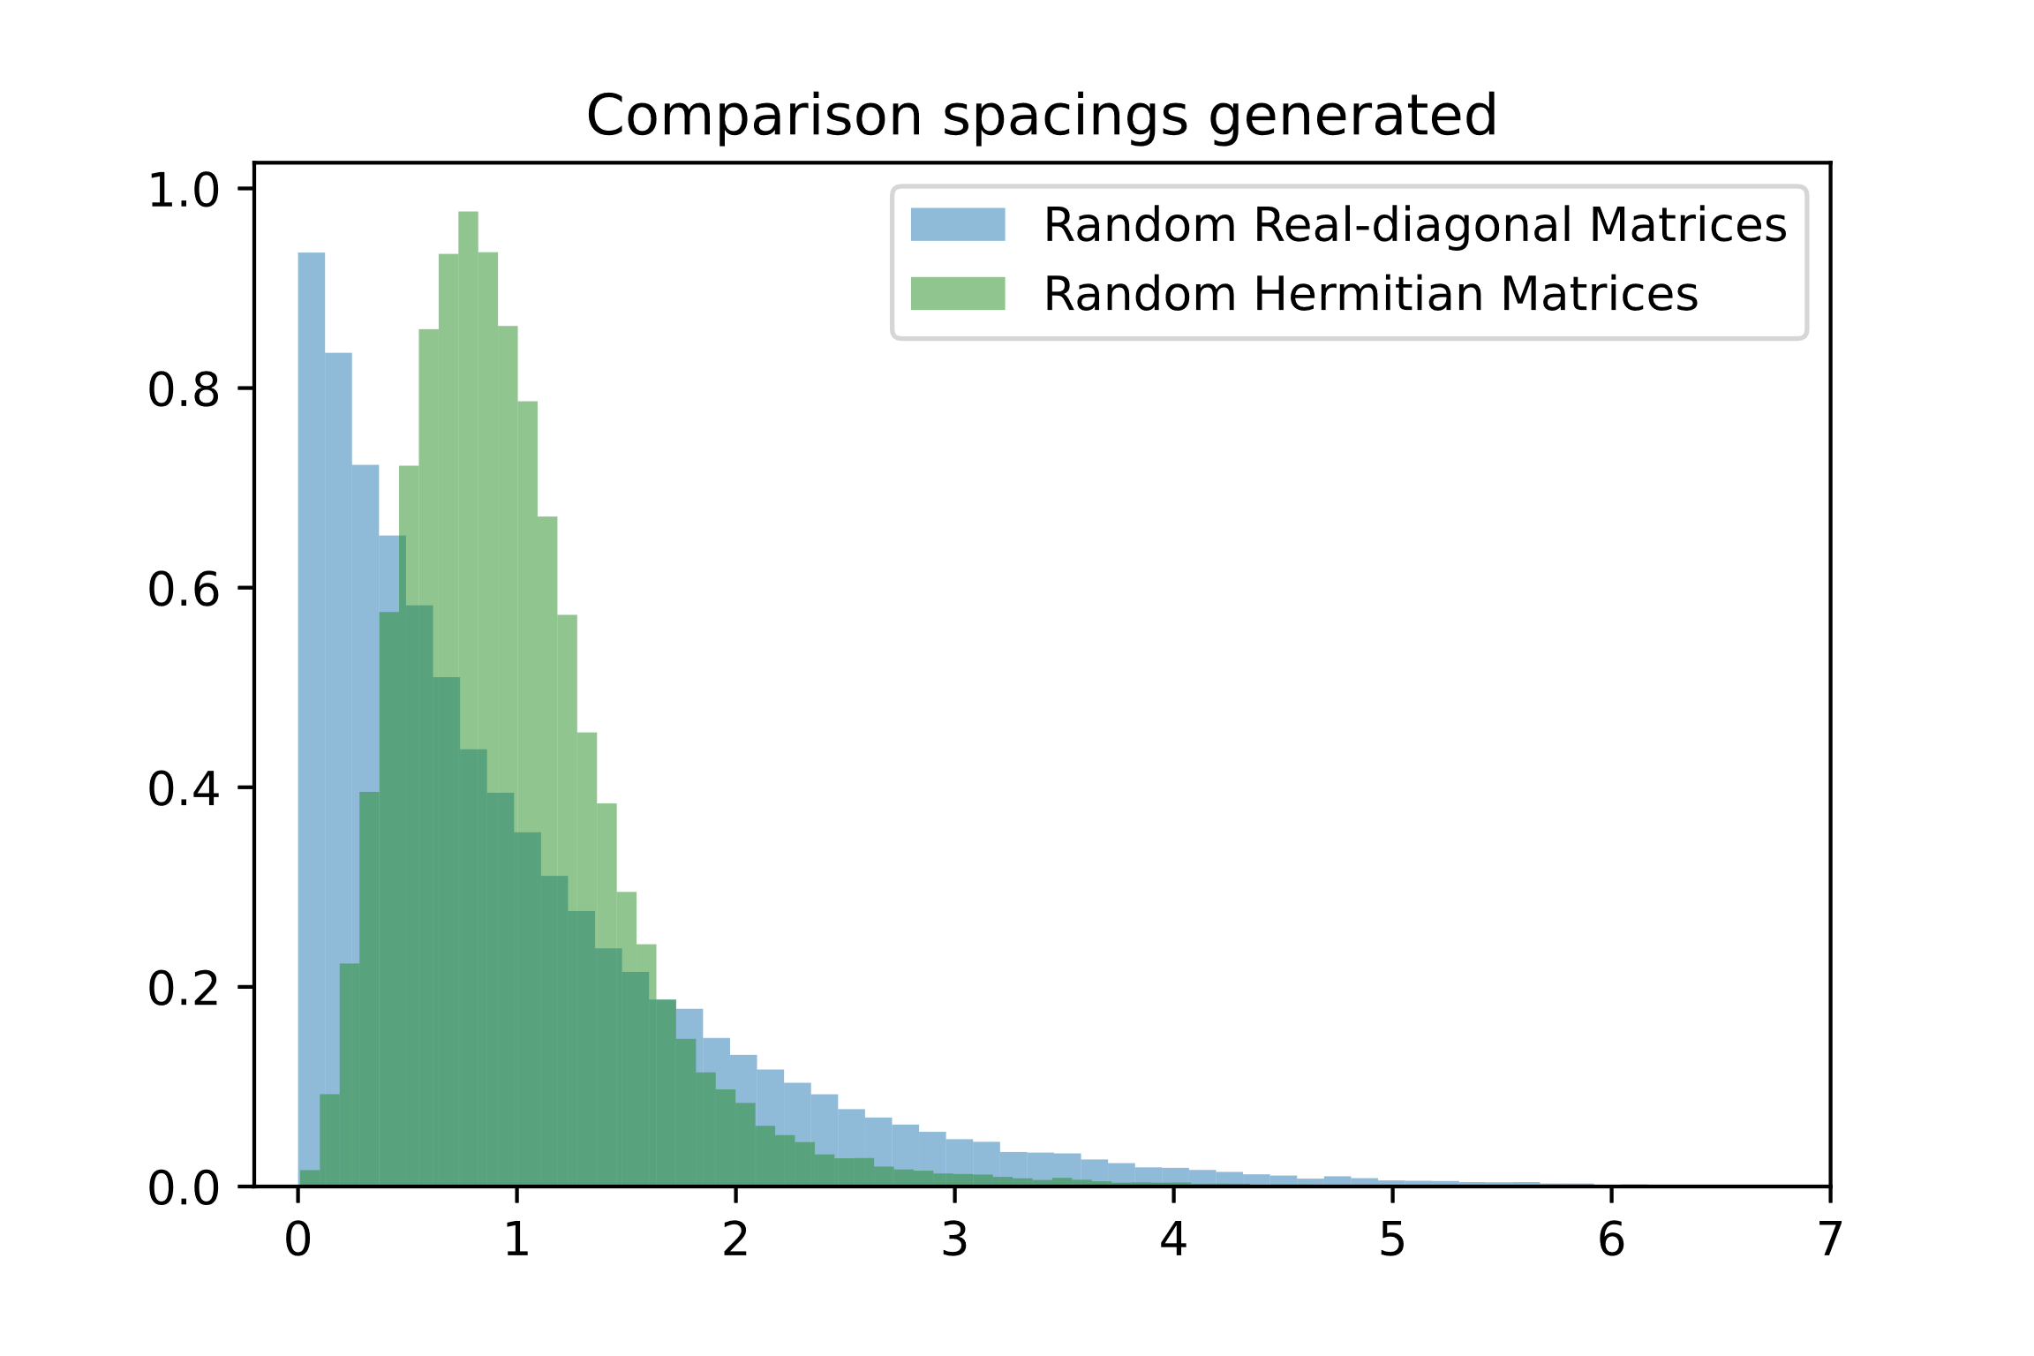
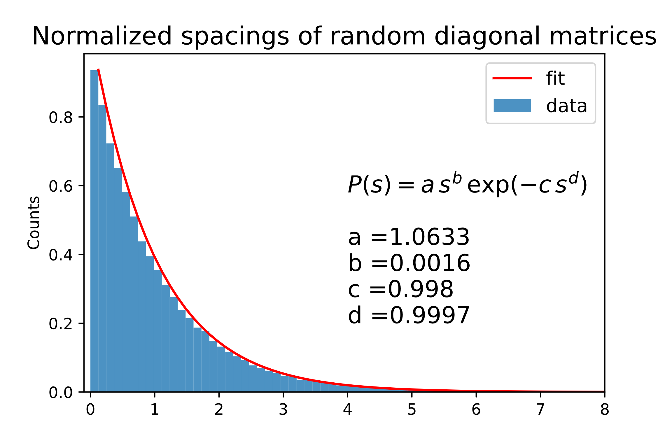
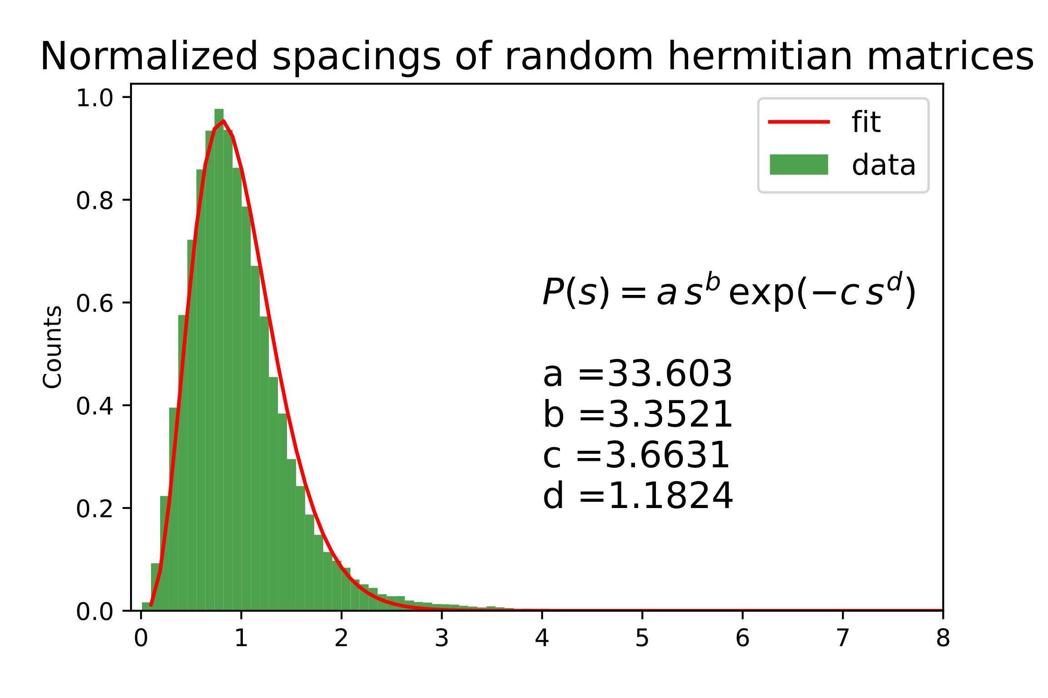
Random Matrix Theory
Notes:
Introduce strategies, tests, and report debugging problems, compilation options

Slide 7
Thanks for the attention
___________________________

